Slide 1






Project 1: Scalable Web Application
with ALB and Auto Scaling
AWS Solutions Architect - Associate
Graduation Project Guide
EC2
ALB
Auto Scaling
RDS
Khalid Mohamed Salman

Slide 2













Project Overview
Project Goals
Architecture Type
Deploy a scalable web application on AWS
Implement high availability architecture
Configure automatic scaling based on demand
Apply security and cost optimization best practices
EC2-based
Traditional compute instances with load balancing and auto scaling
Learning Outcomes
EC2-based web application deployment
Key Technologies
Load balancing and auto scaling implementation
Performance monitoring and alerting
EC2
ALB
Auto Scaling
RDS

Slide 3


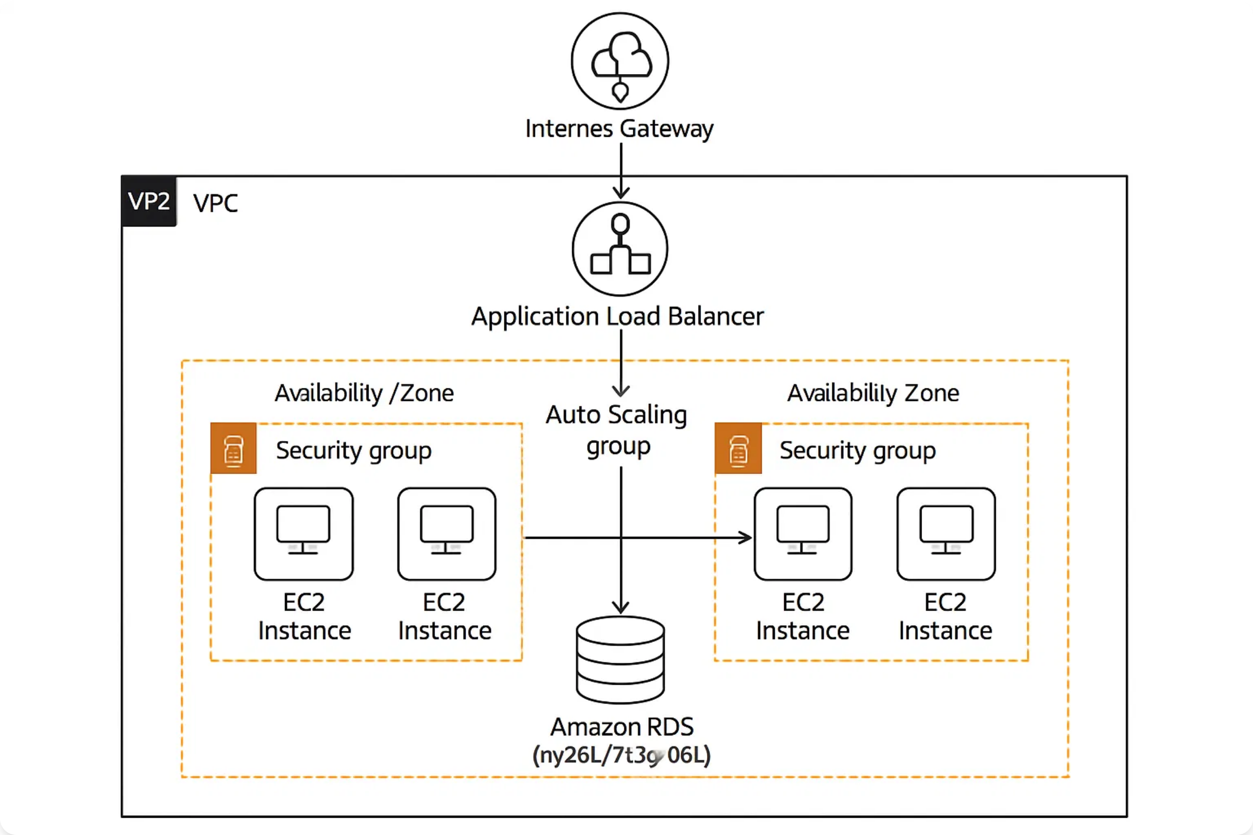


Architecture Diagram
Scalable Web Application Architecture
High availability, auto-scaling, and load-balanced infrastructure
Internet Gateway
Application Load Balancer
EC2 Instances
Amazon RDS
Public access point
Traffic distribution
Auto Scaling Group
Multi-AZ database

Slide 4








Key AWS Services
Amazon EC2
Application Load Balancer
Elastic Compute Cloud
Layer 7 Load Balancing
Virtual servers in the cloud
Distributes incoming traffic
Hosts web application instances
Health checks and failover
Scalable compute capacity
Multiple Availability Zones
Auto Scaling Group
Amazon RDS
Dynamic Scaling
Relational Database Service
Automatically adjusts capacity
Managed database service
Based on demand metrics
Multi-AZ deployment
Cost optimization
Automated backups
IAM for Security
CloudWatch Monitoring
SNS Notifications

Slide 5







Implementation Phases
1
Environment Setup
2
EC2 & AMI Creation
Create AWS account and IAM user
Launch temporary EC2 instance
Generate EC2 key pair
Install and configure web server
Configure VPC and subnets
Create golden AMI
3
Load Balancer Setup
4
Auto Scaling Configuration
Create target group
Create launch template
Configure Application Load Balancer
Configure Auto Scaling Group
Set up health checks
Set scaling policies
5
Database Integration
6
Monitoring & Cleanup
Launch RDS instance
Set up CloudWatch alarms
Configure Multi-AZ deployment
Configure SNS notifications
Update application connection
Clean up resources

Slide 6






EC2 and AMI Setup
Launch EC2 Instance
Web Server Installation
Choose Amazon Linux 2 AMI
# Update system packages
Select t2.micro instance type
sudo yum update -y
Configure security group (SSH + HTTP)
# Install Apache web server
Use your created key pair
sudo yum install -y httpd
# Start and enable Apache
sudo systemctl start httpd
Create Golden AMI
sudo systemctl enable httpd
Select running instance
# Create index page
echo "<h1>Hello from Project 1!</h1>" | sudo tee /var/www/html/index.html
Actions → Create Image
Name: "my-web-app-ami"
Terminate temporary instance
Security Group Rules
Inbound Rules:
• SSH (22) from My IP
• HTTP (80) from Anywhere
Outbound Rules:
• All traffic to Anywhere (default)

Slide 7








Application Load Balancer Configuration
Create Target Group
Security Group for ALB
Configuration:
Inbound Rules:
• Target type: Instances
• HTTP (80) from 0.0.0.0/0
• Protocol: HTTP
• HTTPS (443) from 0.0.0.0/0 (optional)
• Port: 80
• Health check path: /
Outbound Rules:
Health Check Settings:
• HTTP (80) to EC2 security group
• All traffic to 0.0.0.0/0
• Healthy threshold: 2
• Interval: 30 seconds
• Timeout: 5 seconds
Health Check Benefits
Automatic failover
ALB Configuration
Traffic routing to healthy instances
Scheme: Internet-facing
Improved application availability
IP address type: IPv4
Reduced downtime
Select multiple AZs
HTTP listener on port 80
Load Balancer Flow
Internet
ALB
Target Group
EC2 Instances

Slide 8










Auto Scaling Group Configuration
Launch Template
Scaling Policies
Template Configuration:
Target Tracking Policy
• AMI: my-web-app-ami
• Metric: Average CPU Utilization
• Instance type: t2.micro
• Target Value: 50%
• Key pair: your-key-pair
• Scale-out cooldown: 300 seconds
• Security group: web-server-sg
• Scale-in cooldown: 300 seconds
Advanced Details:
• IAM instance profile (optional)
Step Scaling (Optional)
• User data script (optional)
• Scale out when CPU > 70%
• Monitoring: Enabled
• Scale in when CPU < 25%
• CloudWatch alarms trigger scaling
ASG Configuration
Network Configuration
Desired Capacity:
2
VPC: Select your VPC
Minimum Size:
1
Subnets: Multiple AZs (public)
Load balancer: Attach to ALB target group
Maximum Size:
4
Health check type: ELB
Auto Scaling Benefits
Cost Optimization
High Availability
Performance
Automation

Slide 9










Monitoring and Alerts
CloudWatch Metrics
CloudWatch Alarms
EC2 Metrics:
High CPU Alarm
• CPU Utilization
• Metric: CPUUtilization
• Network In/Out
• Threshold: > 80%
• Disk Read/Write
• Period: 5 minutes
• Status Check Failed
• Action: Send SNS notification
ALB Metrics:
• Request Count
Unhealthy Hosts Alarm
• Target Response Time
• Metric: HealthyHostCount
• Healthy Host Count
• Threshold: < 1
• HTTP Error Codes
• Period: 2 minutes
• Action: Send SNS notification
SNS Notifications
Dashboard Creation
Create SNS topic
Subscribe email endpoint
Create custom dashboard
Configure alarm actions
Add metric widgets
Test notification delivery
Configure time ranges
Share with team members
Monitoring Best Practices
Real-time Monitoring
Historical Analysis
Proactive Alerts
Team Collaboration

Slide 10









Best Practices and Cleanup
Security Best Practices
Resource Cleanup Order
Use IAM roles instead of access keys
1
Terminate Auto Scaling Group
Implement least privilege principle
Restrict security group rules
2
Delete Launch Template
Enable CloudTrail for auditing
Use private subnets for databases
3
Delete Application Load Balancer
4
Delete Target Group
Cost Optimization
5
Delete RDS Instance
Use appropriate instance types
Configure proper scaling policies
6
Deregister AMI & Delete Snapshots
Monitor and optimize usage
Use Reserved Instances for production
Set up billing alerts
Project Deliverables
Solution Architecture Diagram
GitHub Repository with documentation
README with setup instructions
Live URL or demo video (optional)
Congratulations!
You've successfully implemented a scalable, highly available web application on AWS
High Availability
Auto Scaling
Load Balancing
Monitoring

Slide 11
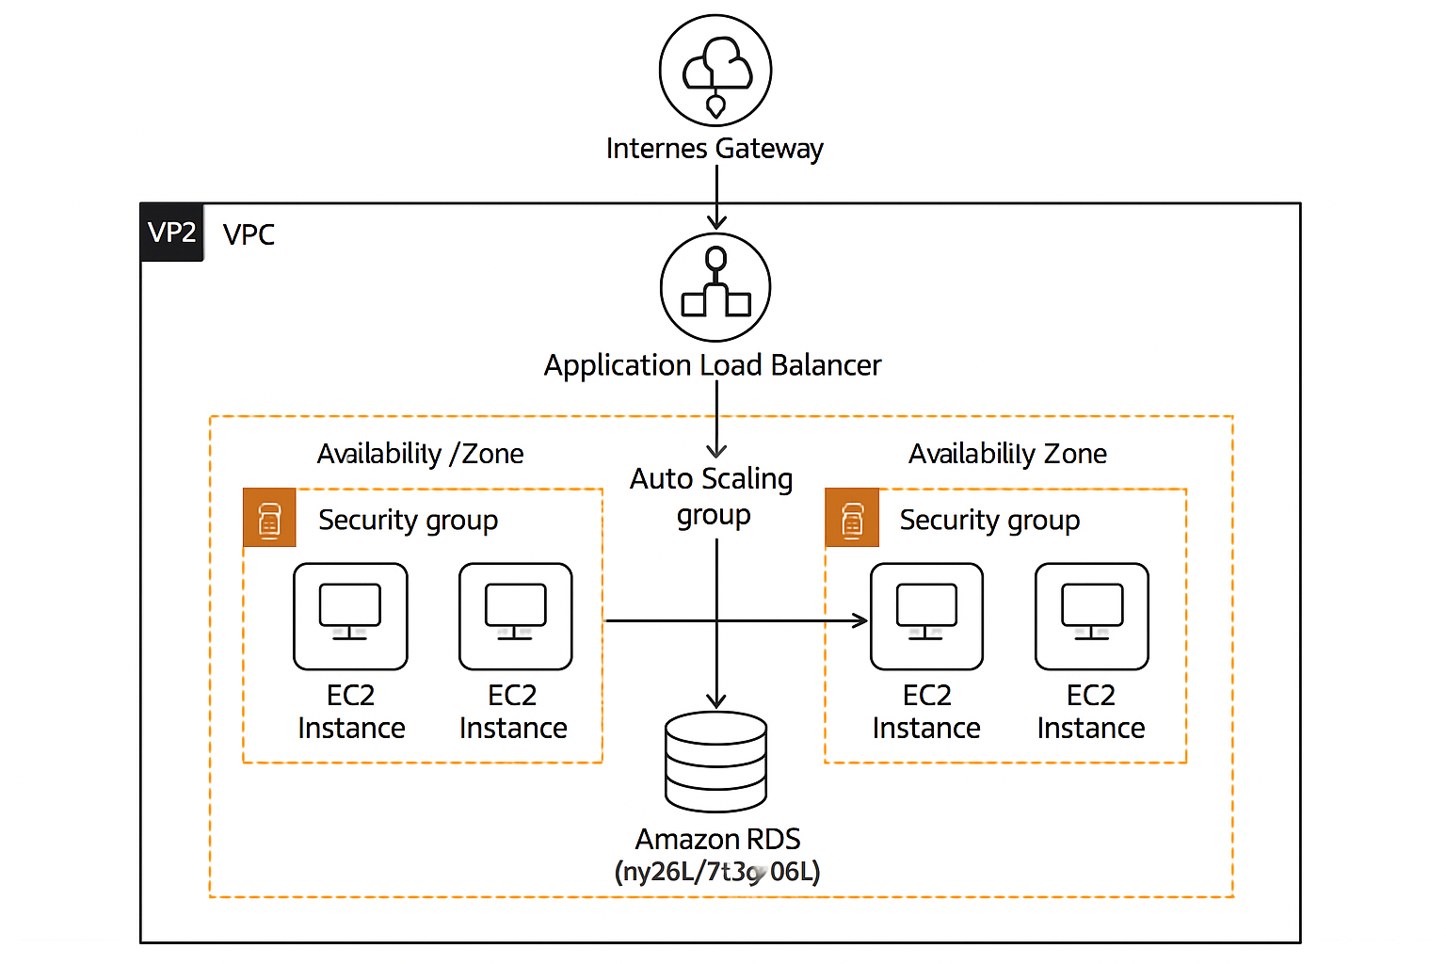
Architecture Diagram

